Slide 1
Mosaic Plot / Marimekko Chart

Slide 2
Marimekko Chart
A mosaic plot (also known as a Marimekko diagram) is a graphical method for visualizing data from two or more qualitative variables.

Slide 3
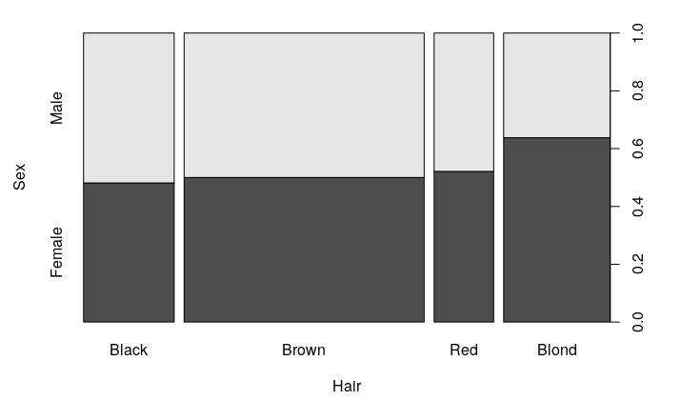
Spine plot
Spine plots are special case of mosaic plots and can be seen as a generalization of stacked bar plots.

Slide 4
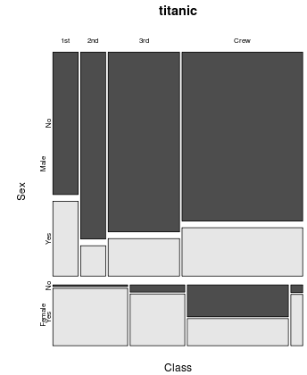
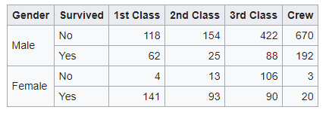
Mosaic plot Construction

Slide 5
Pros and Cons
All of the variables of the Marimekko chart are spatially encoded and it makes it easy to view any pairs of visual attributes independently.
As the amount of data increases, finding difference in only width or height of the rectangles is difficult.
The number of observations is not limited, but not read in the image.
Marimekko is a perfect tool just for the general overview of the dataset.

Slide 6
Tools
Charticular
D3.js
Data illustrator
Fusion Charts
Google charts
High Charts
JMP
Matplotlib
Microsoft Excel
Microsoft Power BI
Microsoft Powerpoint
PlotDB
Tableau
R

Slide 7
THANK YOU

